Slide 1
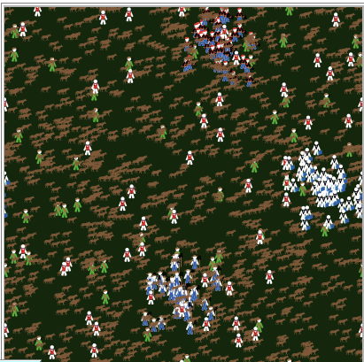
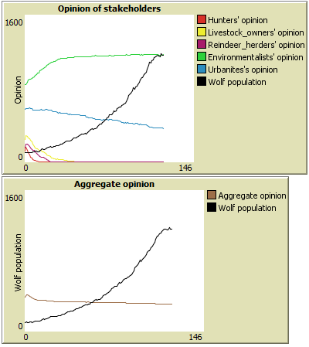
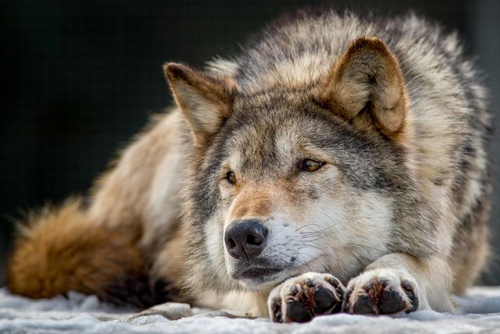
Systems analysis of socio-natural interactions for a sustainable development： a case study of Swedish wolf management
Huayi Lin
Main supervisor: Hans Liljenström
Co-supervisors: Ashok Swain, Dietrich von Rosen, Marie Larsson

Slide 2
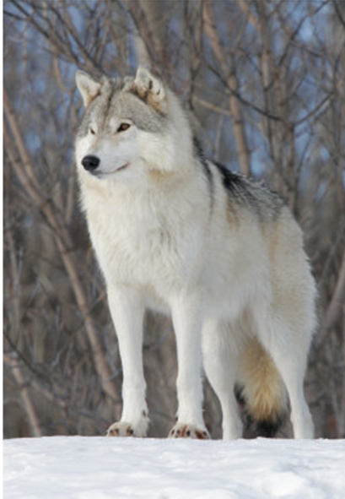
Background
The Swedish wolf population has grown from almost zero in 1960s to about 355 in period 2016/2017.
The wolf is considered a natural part of the Swedish fauna and the Parliament has decided that the species should stay in a healthy population (Naturvårdsverket, 2017).

Slide 3
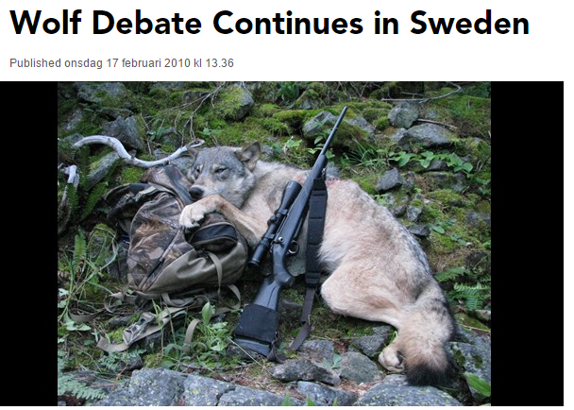
Background
Swedish wolf reestablishment has triggered a hot debate in the society
Different stakeholders have different opinions on the wolf population in Sweden
Some typical stakeholders and their opinions towards wolves
Stakeholder | Opinion towards wolves
Environmentalists | very positive
Urbanites | positive
Hunters (esp with dogs) | very negative
Livestock owners | negative
Reindeer herders | negative

Slide 4
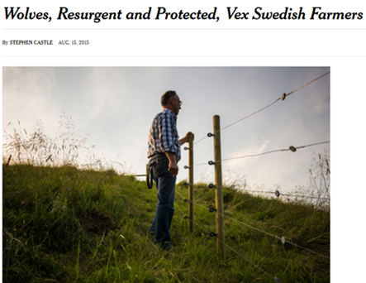
Background
Policy measures
Decentralization of wolf management to the county level
Compensation to livestock owners for livestock losses
Preventative payment to livestock owners
Licensed hunting
Punishment for poaching
Governmental Sami policy (for reindeer herders)
Development of wolf ecotourism
The EU Habitats Directive
The tensions between different stakeholders have not been relieved. Instead, they have developed into a deadlock.

Slide 5
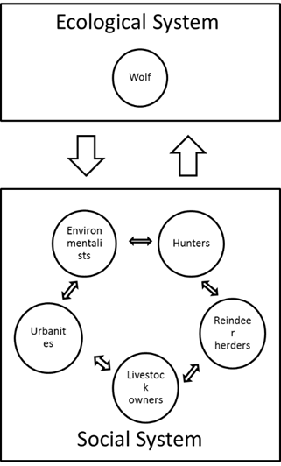

The aim of the study
Use systems analysis to contribute to 1) the understanding of the complex interplay of a specific ecological system and social system, 2) to methodology development, and 3) to guide policy implementation.

Slide 6
Research questions
To what extent can Agent Based Model be used to describe the the opinions and the complex interaction between stakeholders concerned with wolves in Sweden?
Is it possible to find an optimal solution, where the tension between stakeholders is minimized, with a common goal of the Swedish wolf population?
How can trust between the stakeholders be modelled, and how can it be implemented to increase mutual understanding and communication?

Slide 7
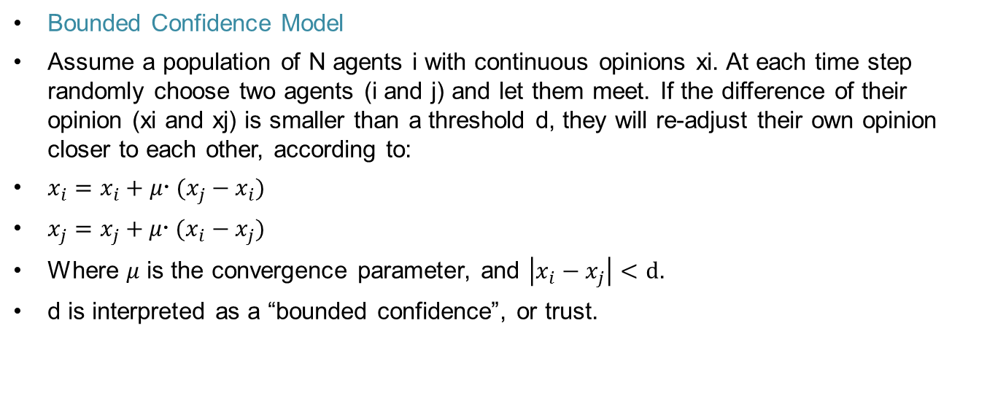
Methods
Bounded Confidence Model
Assume a population of N agents i with continuous opinions xi. At each time step randomly choose two agents (i and j) and let them meet. If the difference of their opinion (xi and xj) is smaller than a threshold d, they will re-adjust their own opinion closer to each other, according to:
$x_{i}=x_{i}+μ (x_{j}−x_{i})$
$x_{j}=x_{j}+μ (x_{i}−x_{j})$
Where $μ$ is the convergence parameter, and $\left|x_{i}−x_{j}\right|<d$.
d is interpreted as a “bounded confidence”, or trust.

Slide 8
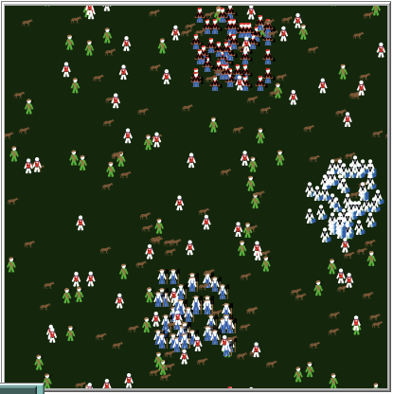
Methods
ABM for the Swedish wolf management
Rules of movement and interaction:
1. When hunters, livestock owners and reindeer herders meet wolves, their opinions turn more negative
2. Hunters can kill wolves with a certain probability.
3. When environmentalists and urbanites meet wolves, their opinions turn more positive. When the wolf population exceeds the desired population, the opinions of these stakeholders stay at the desired population.
4. When stakeholders meet each other, if their opinions are similar to some extend, they will adjust their opinions towards each other.
5. At each time step, the opinions of the stakeholders may change randomly according to some probability.
6. Policies may influence the opinions of the stakeholders.

Slide 9
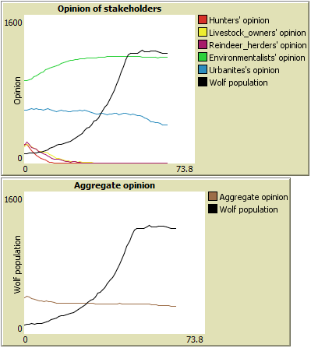
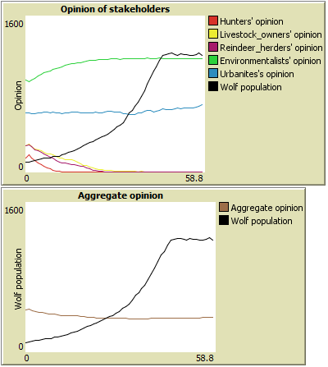
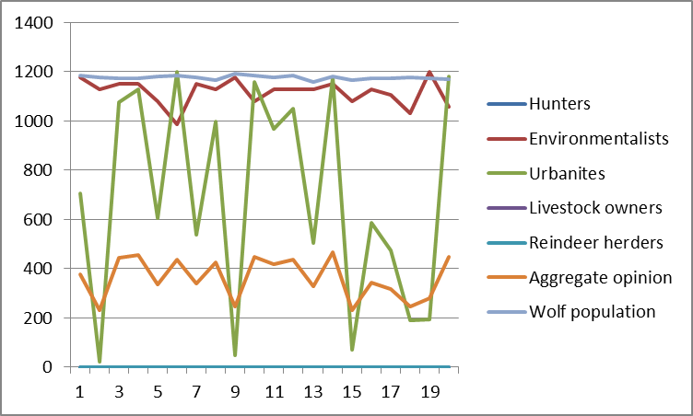
Result
Results for 20 simulation runs

Slide 10
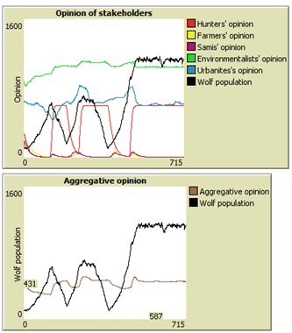
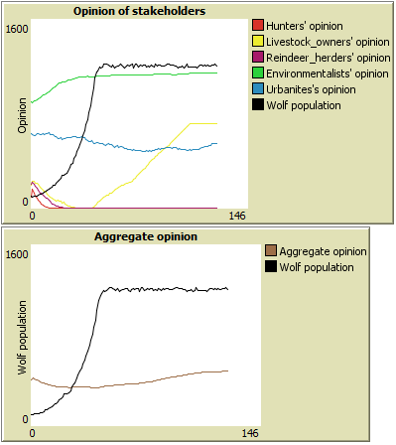
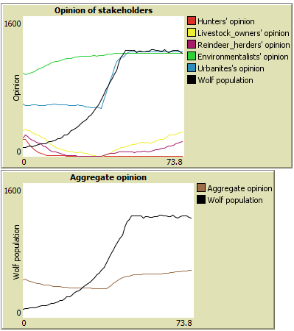
Scenario simulation
Licensed hunting
More compensation on fencing
Eco-tourism

Slide 11
Thank you!
Questions are welcome!

Slide 12
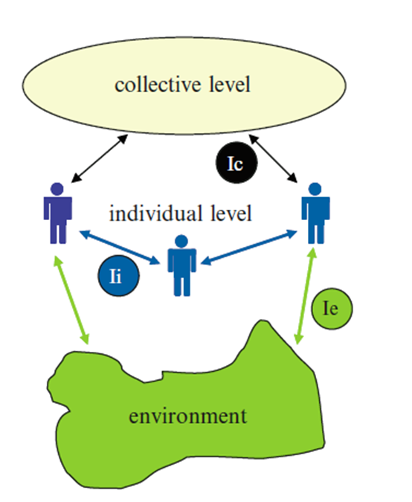
Study II: Methods
Interactions between agents via the environment (Ie), through peer to peer communication (Ii) and via the collective level (Ic).
Interaction between humans with different attitudes and wolves; effect of human-wolf encounter

Slide 13
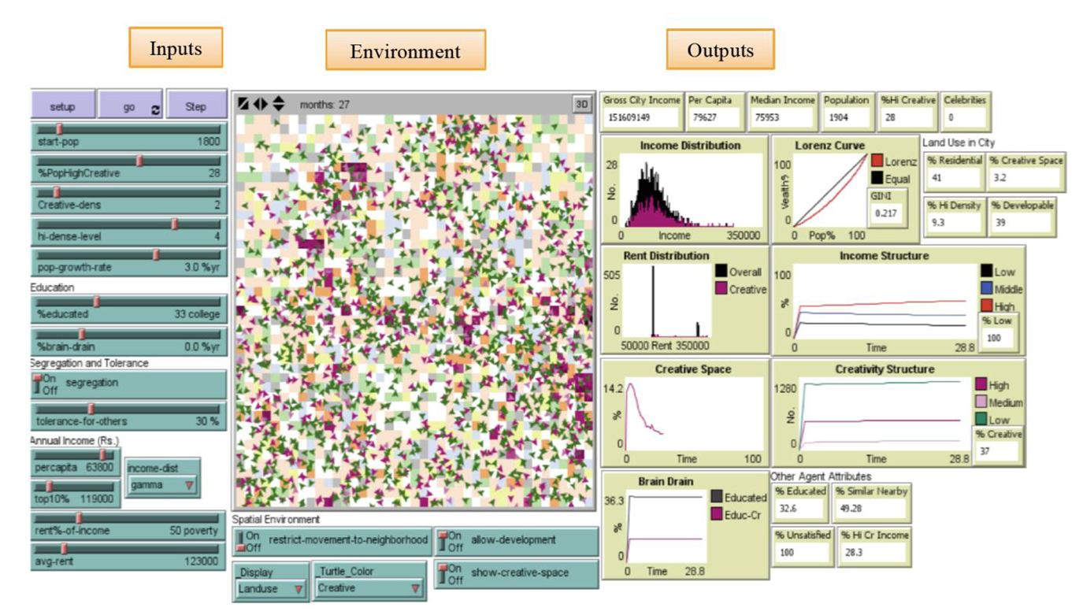
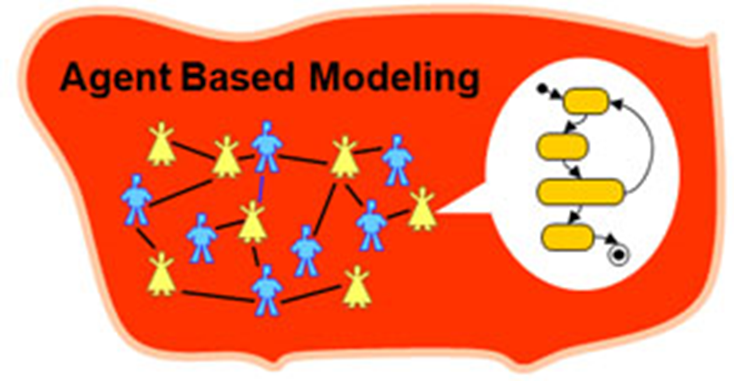
Study II: Methods
Agent Based Model (ABM)
Models designed to:
“Situate an initial population of autonomous heterogeneous agents in a relevant spatial environment; allow them to interact according to simple local rules, and thereby generate – or ‘grow’ – the macroscopic regularity from the bottom up.” (Epstein 1999:42)

Slide 14
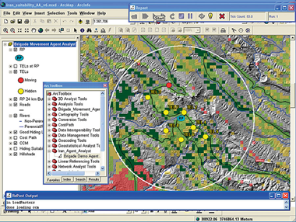
Study II: Methods
The use of ABMs to study the emergence of cooperation and sustainable resource use is not new. It has been shown to be valuable in numerous studies.
Theoretical Issues in Environmental Management
Dynamics of Land-Use/Cover Changes
Water Management
Forestry
Wildlife
Agriculture
Livestock Management

